Slide 1
free swimming

Slide 3


Slide 4
gap

Slide 5
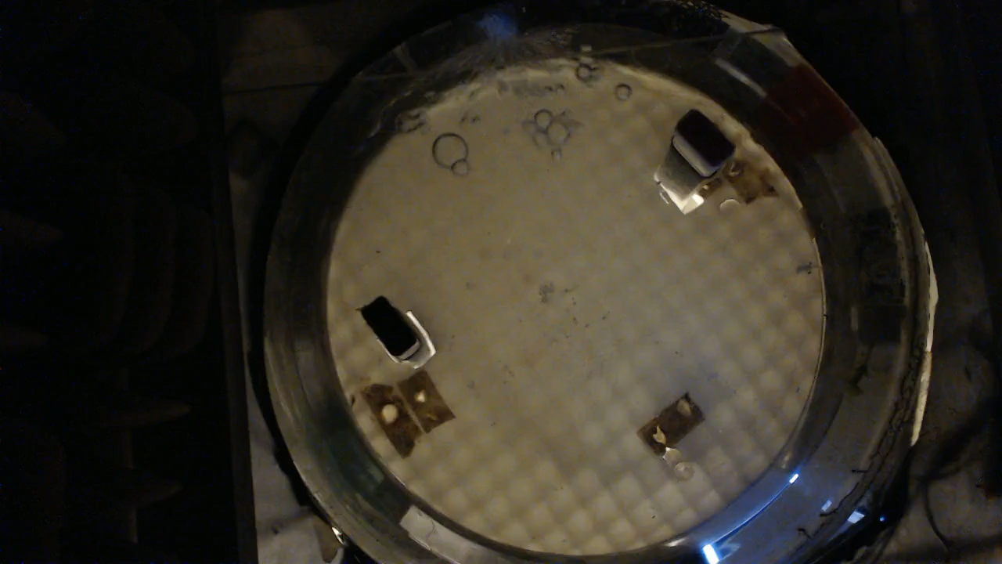

Slide 6
break

